Slide 1
Verifiable Credentials for Trade Finance
Onyx SSI Hackathon
Prashant Baj / prashant.baj@gmail.com / +91 9970160472

Slide 2




Introduction to Use Case – Current Industry practice
1. Sale Agreement
Manufacturer Exporter
5. Shipment
Merchant Importer
Current Pain Point
LC often paper based are hard for verification.
Inefficient Process
Frauds around LCs results in billions of dollars losses annually.
2. Requests LC
4. LC Verification
Advising /
Confirming Bank
Issuing Bank
3. Issue LC

Slide 3
Solution – LCs as verifiable Credentials
1. Sale Agreement
4. LC VP Verification
Letter of Credit issued as Verifiable Credential can solve the trust and verification issue resulting in efficient, transparent and secured process.
Assumption is all parties are members on a blockchain network.
In advanced trade finance practices, delegation of digital identities can play a crucial role.
There are extension use cases to leverage DID and VC infrastructure
Manufacturer Exporter
5. Shipment
Merchant Importer
2. Requests LC
3. LC VP
4. LC VP Verification
3. Issue LC VC
Advising /
Confirming Bank
Issuing Bank
Verification of VP by Advising Bank can be optional depending upon transaction

Slide 4
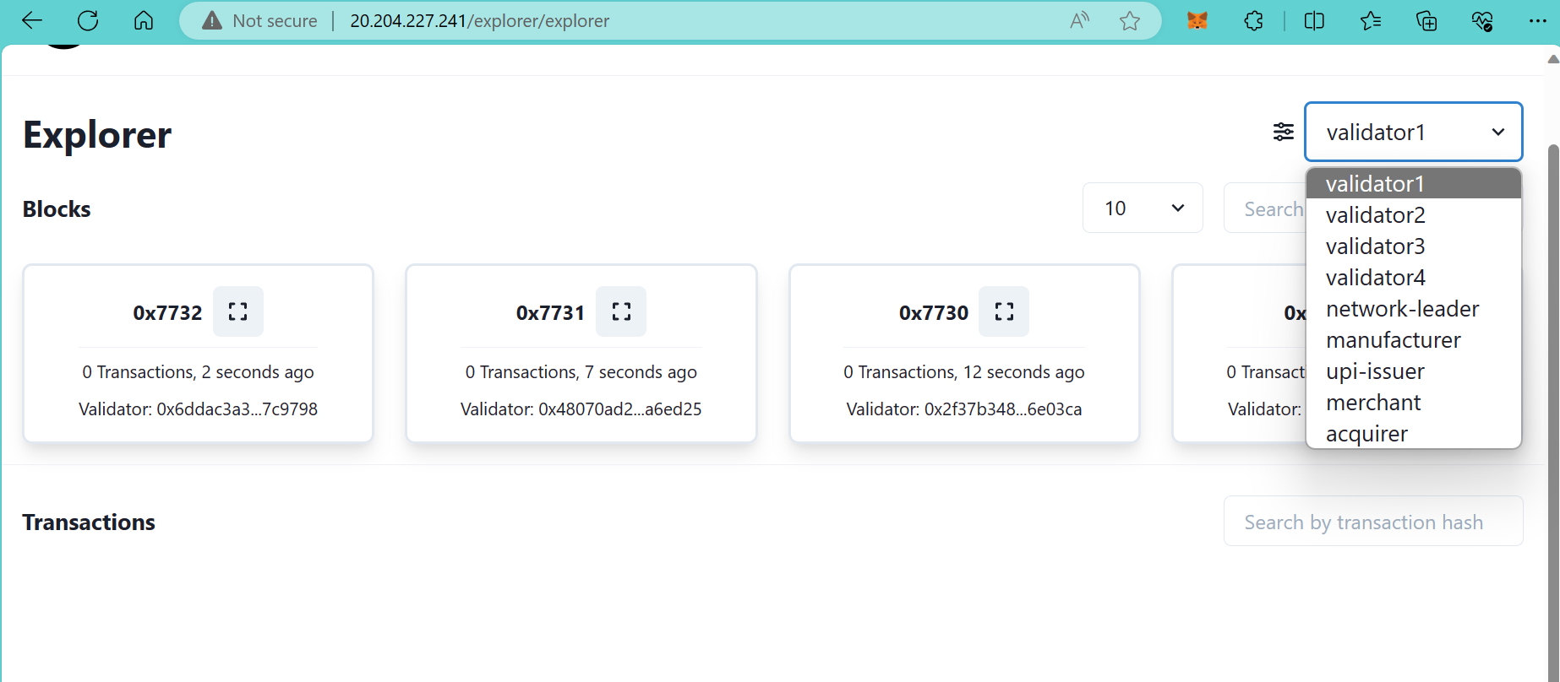
Demo
Deployed a Hyperledger Besu network private permissioned network in Azure Cloud

Slide 5
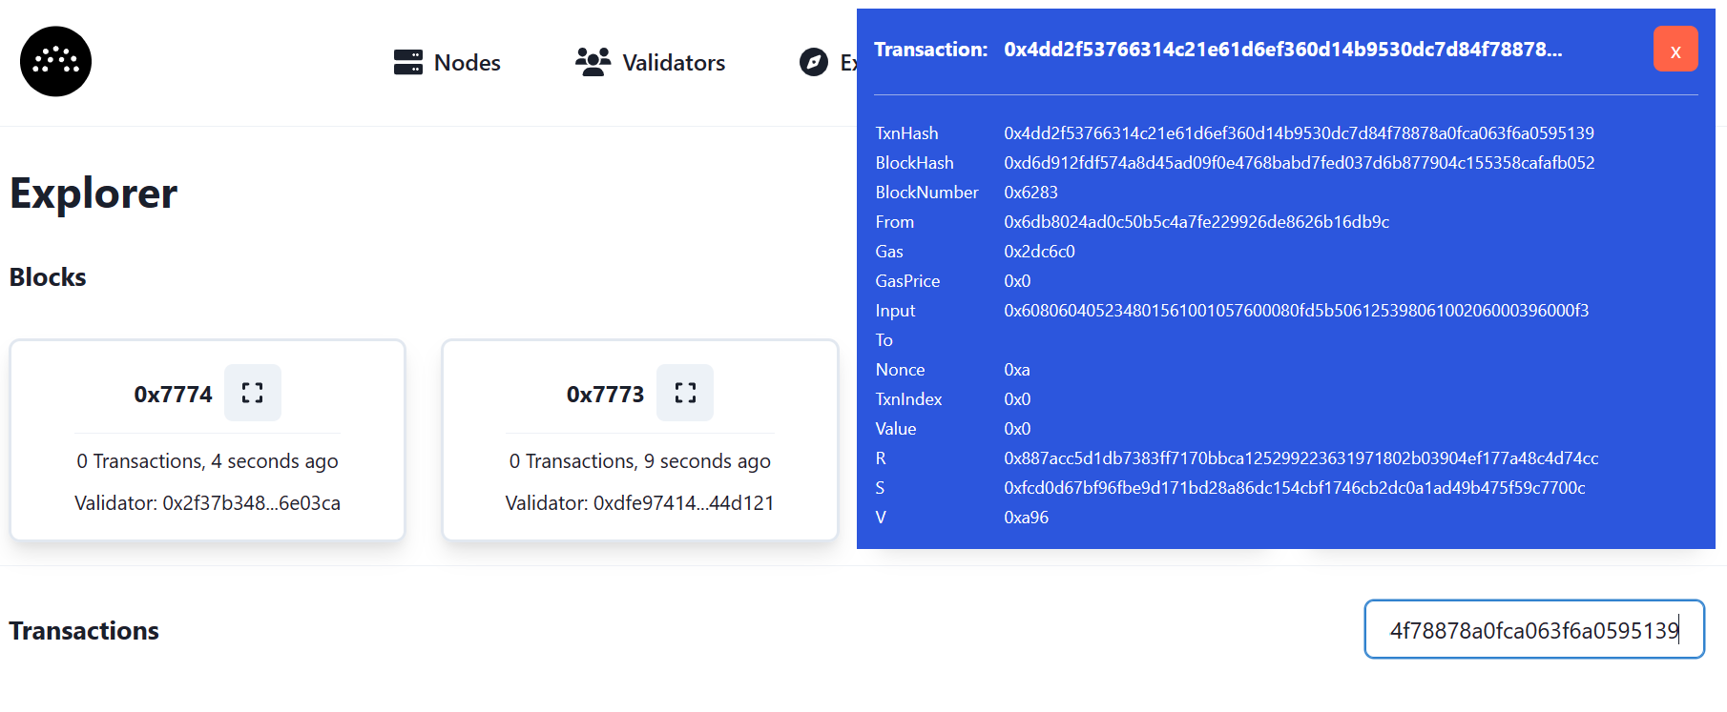
Demo
Deployed Registry Contract

Slide 6
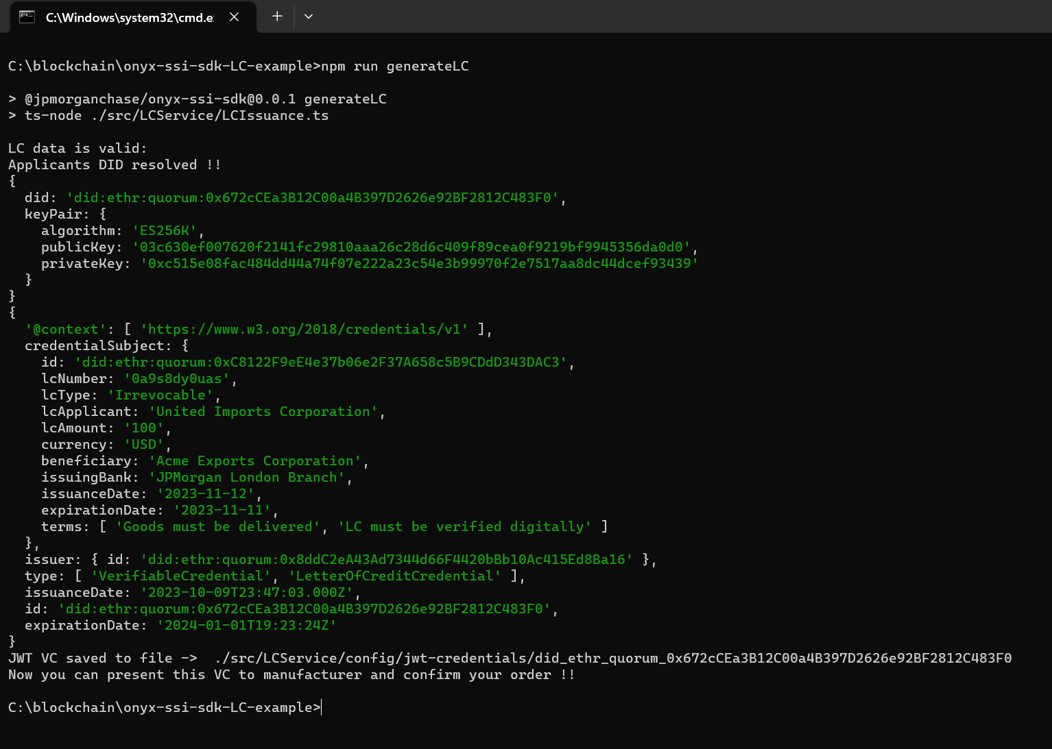
Demo
Issuance of LC
A JWT VC of LC created in favour of Importer or merchant.

Slide 7
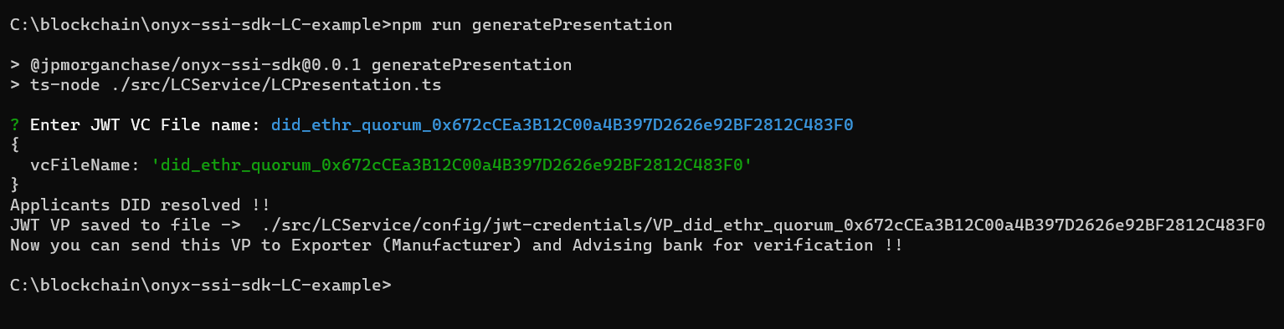
Demo
Presentation of LC (VP)
Importer created VP and expected to share with Exporter and/or Advising Bank

Slide 8
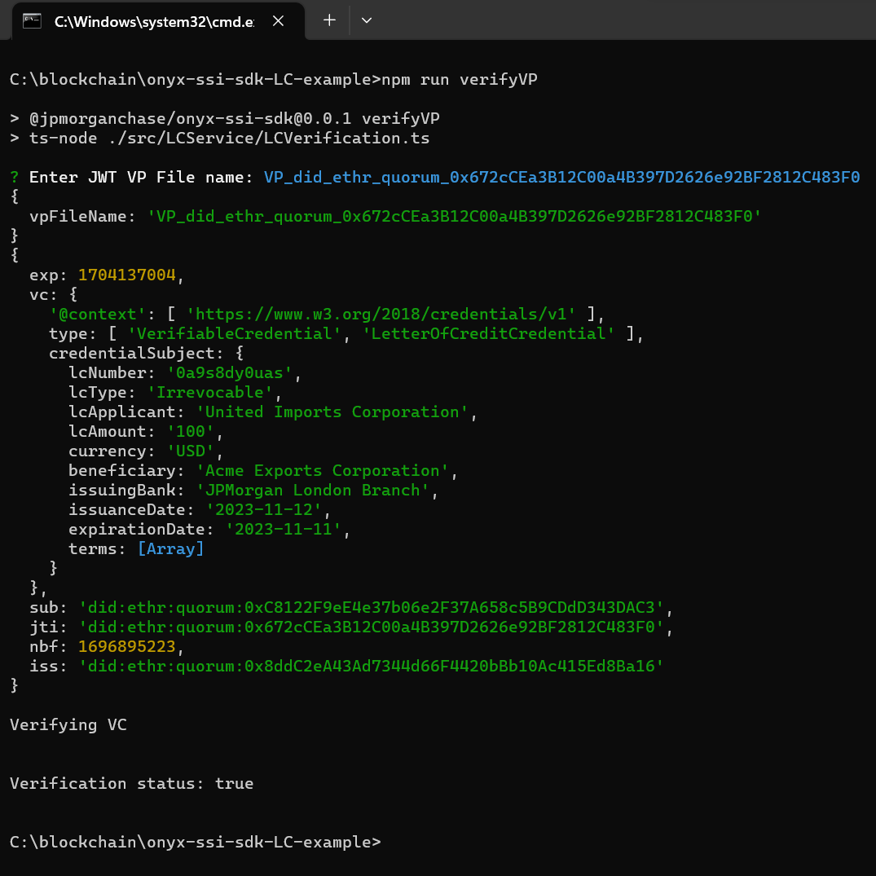
Demo
Presentation of LC (VP)
LC is digitally verified

Slide 9
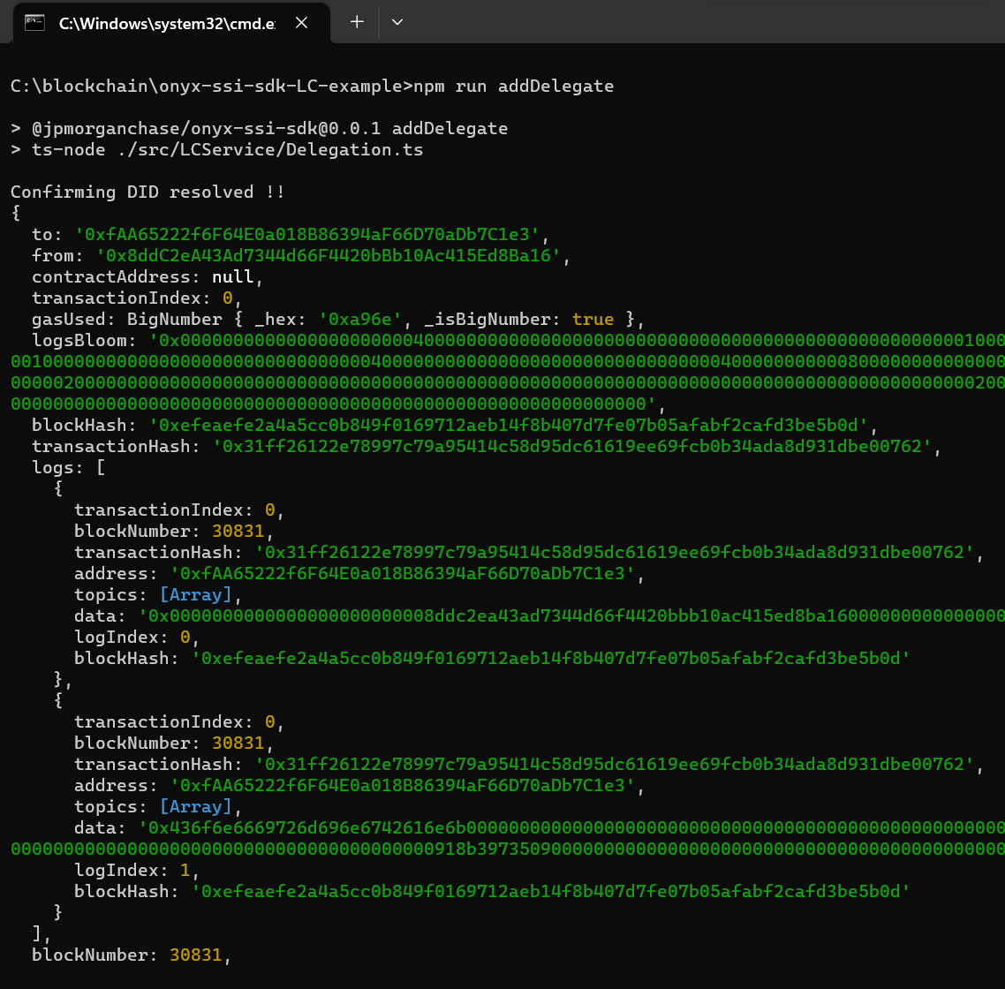
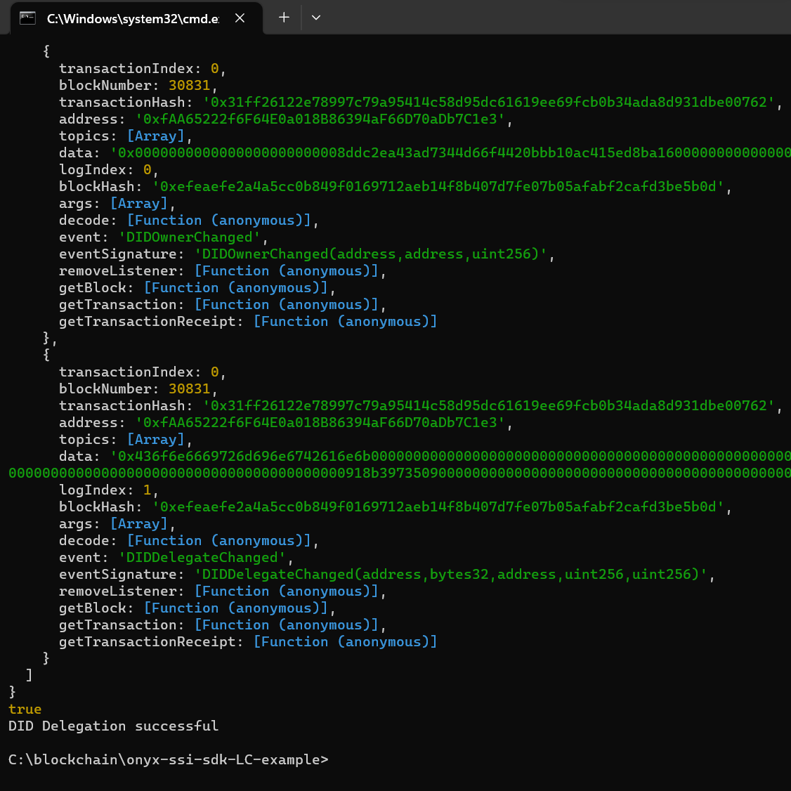
Demo
Set Attribute and Add Delegate method added
Method added but use case to be expanded to use them

Slide 10
Demo
Future Work
We intend to expand the use use and build smart contract based trade finance application on a permissioned blockchain network. We intend to enhance the security by way of exploring privacy feature.

